Slide 1

What does the fox say?

Slide 2

What Mozilla known for
Mozilla is generally seen as a positive force in the tech world. They are known for their commitment to an open and accessible internet, advocating for user privacy, security, and digital rights. Their open-source projects, like the Firefox browser, are designed to give users.
Mozilla's mission and principles focus on promoting openness, innovation, and opportunity on the web, which aligns with their goal of making the internet a public resource that benefits.
They also engage in various initiatives to improve internet health, such as fighting misinformation and enhancing digital.

Slide 3

What all the fuzz is about
Mozilla changed their TOS and the community freaked out.
The new TOS removed the following section

Slide 4
Does Firefox sell your personal data?
Nope. Never have, never will. And we protect you from many of the advertisers who do. Firefox products are designed to protect your privacy. That's a promise.

Slide 5

Community flipped
Many people were using Firefox only because Mozilla advertised their browser as a Privacy-first solution. They did not like this change in ToS at all.
In fact, Mozilla was using ads and sponsored shortcuts for years

Slide 6
CCPA compliance?
Prior to updating their Terms of Use, Mozilla had publicly assured that they did not and would never sell user data.
However, under the California Consumer Privacy Act (CCPA), some of Mozilla’s existing business practices might have been legally interpreted as ‘selling data.’ Although there is no confirmed evidence of Mozilla violating the CCPA, their data-sharing practices placed them in a legally ambiguous position

Slide 7

The real problem
Mozilla as a company is growing financially but not making any significant changes for a while.

Slide 8
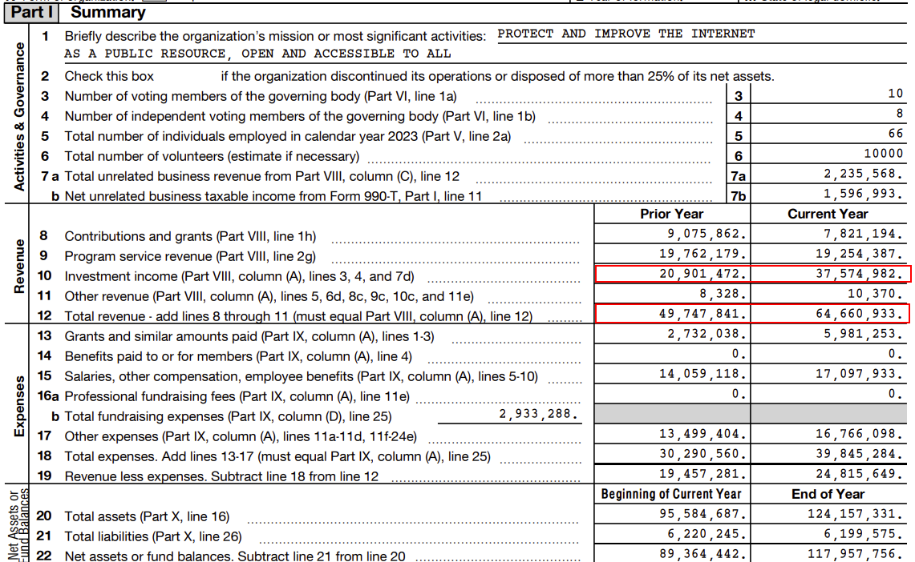
Financial report

Slide 9
Free
Money
Problem

Slide 10
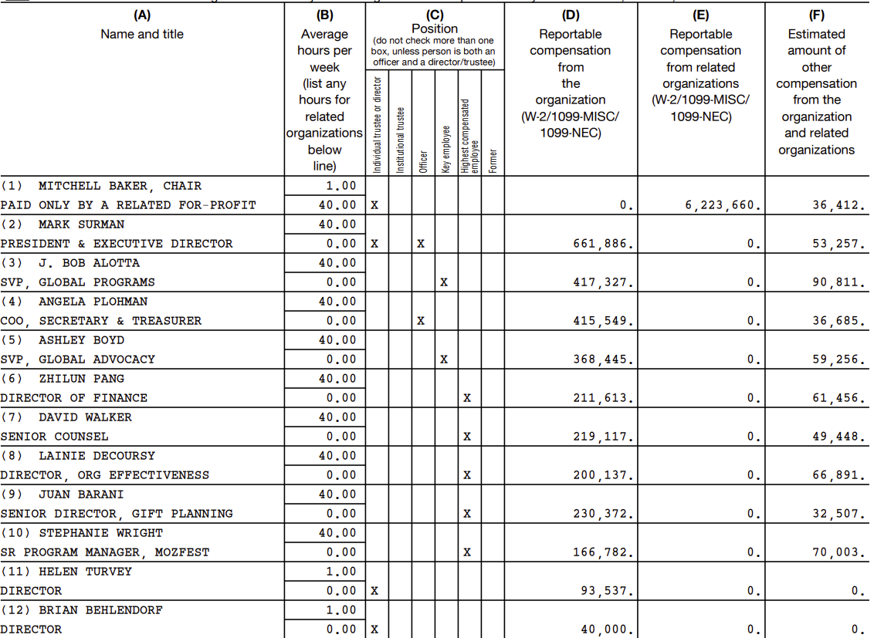
Form 990 (2023)
Let’s have a look at the salaries of their management this year.
It’s a non-profit organization that relies on our donations after all.
It takes them two scrolls on the website to ask you to donate.
Notes:
B200-mozilla-foundation-form-990-public-disclosure-ty23.pdf

Slide 11
State of the industry
Year | Company | Executive | Compensation | Total Revenue | % of Revenue
2018 | Google | Sundar Pichai | $1,881,066 | $136,819,000,000 | 0.0014%
2023 | Google | Sundar Pichai | $8,802,824 | $307,394,000,000 | 0.0029%
2018 | Mozilla | Mitchell Baker | $2,458,350 | $450,860,000 | 0.55%
2023 | Mozilla | Mitchell Baker | $6,223,660 | $653,012,000 | 0.95%
2023 | Mozilla | Mark Surman | $661,886 | $64,660,933 | 1.02%

Slide 12
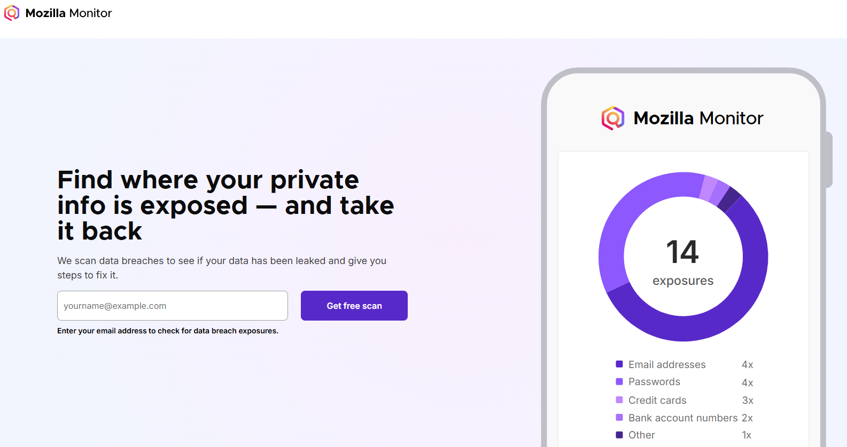
New-ish products

Slide 13

New-ish products

Slide 14

Is there a solution?

Slide 15
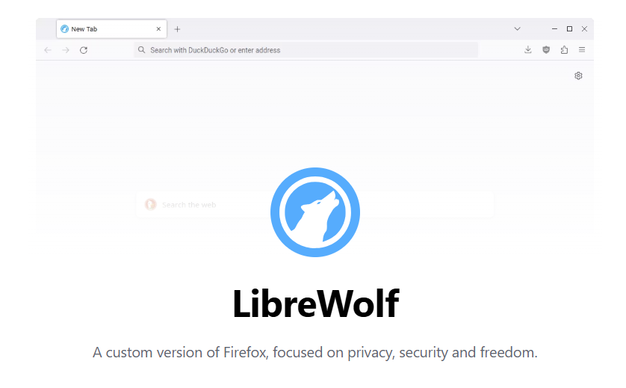

Slide 16
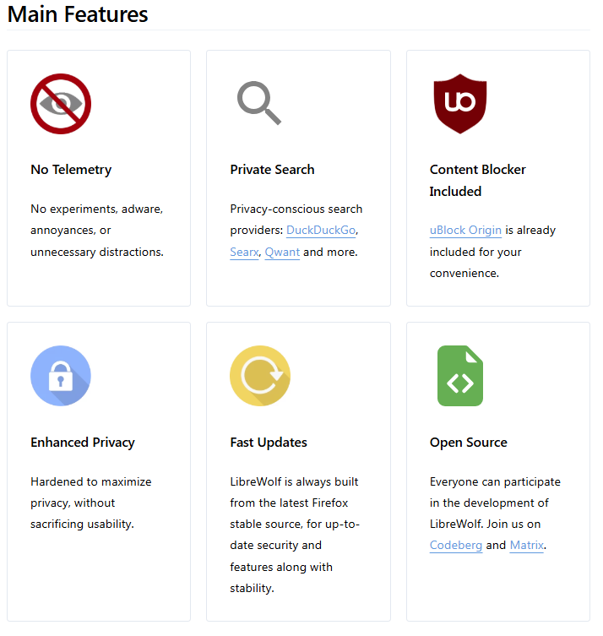

Slide 17

What do you think?

Slide 18

Thank you

